Slide 1

EQ-sol
Project Batch #5

Slide 2

Meet our Team!
Omkar R (31)
Adhithya T (1)
Akshay TA (5)
Karun Krishnan (21)

Slide 3
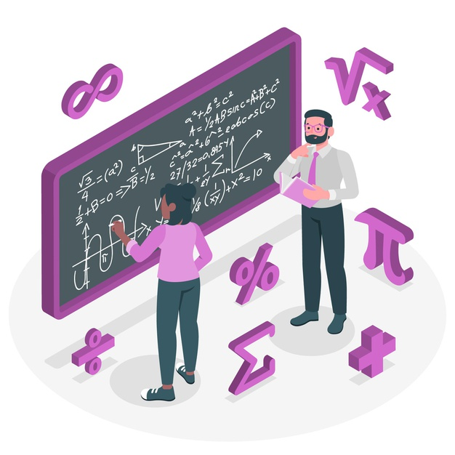
Problem Statement
We are mostly used to handwritten mathematical equations.
Sometimes, you want to find the solution online, but it is cumbersome to translate the handwritten equation onto the computer.
We offer an easier (and more convenient) way to solve handwritten mathematical equations

Slide 4

Introduction
EQ-sol is an application where the user scans handwritten mathematical equations, and the corresponding solutions are displayed by the application.
Some of the features include:
Linear equations
Quadratic equations
Logarithms (and Euler numbers)
And more

Slide 5

Methodology
A picture of the handwritten equation is taken as input.
Convolutional Neural Network (CNN) is used to extract mathematical symbols (including numbers)
Basic python operations along with additional libraries such as Math and SciPy are used to solve the equation
React and Flask is used to create the app

Slide 6

Requirements
A PC with sufficient GPU to train the model
A handwritten dataset containing mathematical symbols (including numbers)
The required programming libraries and framework
Handwritten math symbols dataset

Slide 7

Conclusion
In a place where most of everything we do is handwritten, EQ-sol is a convenient tool that eases our process of finding solutions
Reference papers:
Deep Learning for Symbolic Mathematics
Camera Based Equation Solver for Android Devices

Slide 8

Thank You

